Slide 1
Managing Multi-Generations In The Workplace
Strategies for Effective and Enjoyable Workplace Management

Slide 2
Understanding The Generational Workplace Gap
Recognizing the impact of Generational Difference in the workplace
Overview of the different generations in the workplace?
Fun and practical management strategies?
Creating an inclusive and dynamic work environment

Slide 3
Why generational differences matter in the workplace
1. Influences attitudes:
Generational experiences shape perspectives and approaches to work.
2.Behaviors:
Different generations exhibit unique work habits and professional conduct.
3. Communication style:
Preferences range from face-to-face interaction to digital communication.
4. Collaboration:
Teamwork dynamics vary across age groups, influencing how projects are completed.
5.Productivity
Each generation has its own methods and tools for achieving efficiency
6. Overall work environment:
The blend of generational traits impacts workplace culture and atmosphere.

Slide 4
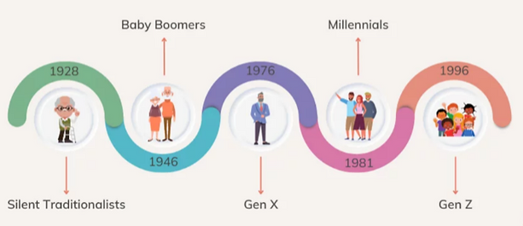
Meet the Generations
Generation Z (Born 197-present)
Millennials (Born 1981—1996)
Generation X (Born 1965-1980)
Baby Boomers (Born 1946-1964)
Silent Generation (Born 1928-1945)

Slide 5
Generation Z (Born 1997-present)
Experiences : Never known a world without smartphones and Wi-Fi
Traits: Digital natives, value diversity, entrepreneurial, competitive
Managing Gen Z:
Offer Flexibility
Involve them in the process
Invest in their development
Create mentor, coaching and learning opportunities with senior staff.

Slide 6
Millennials (Born 1981-1996)
Experiences: 911,expansion of social media, Popularized Avocado Toast
Traits: Tech Savvy, Value feedback, seek purpose, creative, multi-taskers
Managing Millennials:
Encourage work life balance
Provide regular feedback
Be transparent and invite questions
Assign collaborative work teams
Be a good listener

Slide 7
Generation X (Born1965-1980)
Experiences : They grew up with MTV,AIDS, nicknamed “Latch Key Kids”.
Traits: Independent, resourceful, value work-life balance, flexible
Leading Gen X:
Be Flexible(work from home)
Low supervision
Allow them to help you bridge Gaps
Communicate Clearly
Provide a structure
This Photo by Unknown Author is licensed under CC BY

Slide 8
Baby Boomers (Born 1946-1964)
Experiences: Witnessed the moon landing, civil rights movement, assassination of JFK&MLK, rock “n” roll music
Traits: Strong work ethic, goal-oriented, hardworking, resourceful, competitve
Leading Boomers:
Assign high-impact projects
Provide public recognition and perks
Build positive relationships
Provide clear instructions
Value their experience(provide opportunities to mentor)
In-person communication

Slide 9
Silent Generation (Born 1928-1945)
Experiences : War World II, rebuilt the economy post-great depression. Joe Biden is the first president from this generation.
Traits: Respectful, thrifty, loyal, resilient, determined, strong work ethic
Managing the Silent:
Offer part time work options
Encourage in person discussions
Provide feedback
Foster opportunities for knowledge sharing
Be Patient
This Photo by Unknown Author is licensed under CC BY

Slide 10
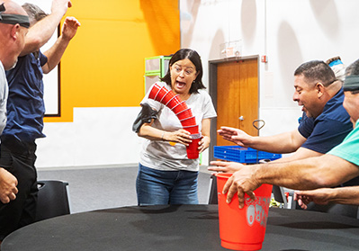
Managing Generations Effectively
Embrace generational diversity; diversity is strength
Accommodate different learning styles
Use varied communication methods
Leverage senior staff as mentors and coaches
Set common goals and foster teamwork
Develop a culture that values each person’s opinion
Encourage knowledge sharing
Consider hosting team-building exercises centered around engaging multiple generations
Understand and meet the needs of each generation

Slide 11
Thank you!
Quiz Time
Go to play.blooket.com and enter the Game ID on the screen or scan the QR Code

